Slide 1
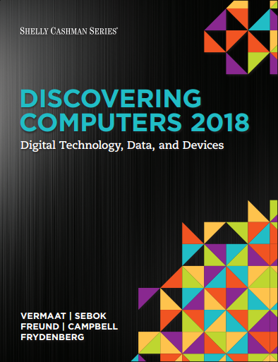

DISCOVERING COMPUTERS 2018 Digital Technology, Data, and Devices
Module 8
Digital Storage: Preserving Content Locally and on the Cloud
Copyright © 2018 Cengage Learning®. May not be scanned, copied or duplicated, or posted to a publicly accessible website, in whole or in part.

Slide 2
Objectives Overview (1 of 2)
Differentiate between storage and memory
Describe the characteristics of internal hard disks
Describe the benefits of solid-state drives
Identify uses of external hard drives and RAID
Differentiate among various types of memory cards and USB flash drives

Slide 3
Objectives Overview (2 of 2)
Discuss the benefits and uses of cloud storage
Describe characteristics of and differentiate among types of optical discs
Explain types of enterprise storage
Identify uses of magnetic stripe cards, smart cards, RFID tags, and NFC tags

Slide 4
Storage (1 of 10)
A storage medium is the physical material on which a computer keeps data, information, programs, and applications
Cloud storage keeps information on servers on the Internet, and the actual media on which the files are stored are transparent to the user

Slide 5
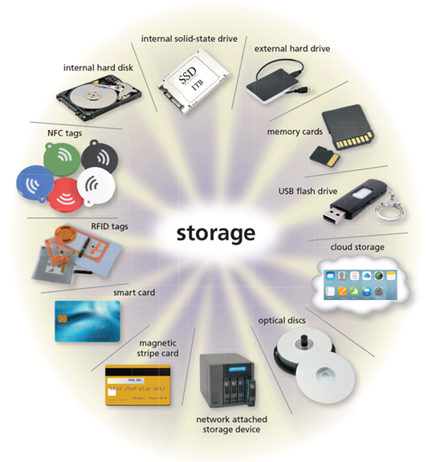
Storage (2 of 10)
Figure 8-1 A variety of storage options.

Slide 6
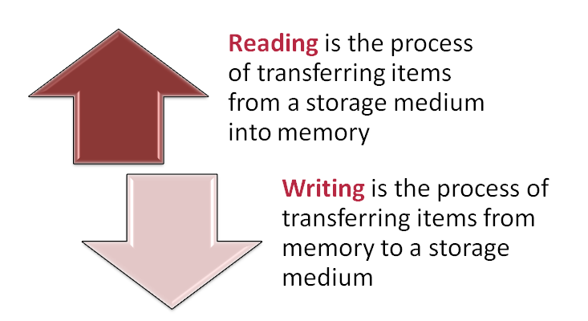
Storage (3 of 10)
A storage device is the hardware that records and/or retrieves items to and from storage media
Notes:
Figure 2.1 Exercise/exercise dropout cycle

Slide 7
Storage (4 of 10)
Capacity is the number of bytes a storage medium can hold
Table 8-1 Terms Used to Define Storage
Storage Term | Approximate Number of Bytes | Exact Number of Bytes
Kilobyte (KB) | 1 thousand | 2¹⁰ or 1,024
Megabyte (MB) | 1 million | 2¹⁰ or 1,048,576
Gigabyte (GB) | 1 billion | 2³⁰ or 1,073,741,824
Terabyte (TB) | 1 trillion | 2⁴⁰ or 1,099,511,627,776
Petabyte (PB) | 1 quadrillion | 2⁵⁰ or 1,125,899,906,842,624
Exabyte (EB) | 1 quintillion | 2⁶⁰ or 1,152,921,504,606,846,976
Zettabyte (ZB) | 1 sextillion | 2⁷⁰ or 1,180,591,620,717,411,303,424
Yottabyte (YB) | 1 septillion | 2⁸⁰ or 1,208,925,819,614,629,174,706,176

Slide 8


Storage (5 of 10)
An Illustration of Volatility
State of Computer
Figure 8-2 A screen display is considered volatile because its contents disappear when power is removed. Likewise, most RAM is volatile. That is, its contents are erased when power is removed from a computer or mobile device. Storage, by contrast, is nonvolatile. Its contents remain when power is off.

Slide 9
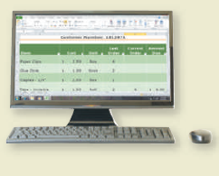

Storage (6 of 10)
Screen Display Volatile
Figure 8-2 A screen display is considered volatile because its contents disappear when power is removed. Likewise, most RAM is volatile. That is, its contents are erased when power is removed from a computer or mobile device. Storage, by contrast, is nonvolatile. Its contents remain when power is off.
Notes:
Our environment is not conducive to a healthy, physically active lifestyle.

Slide 10
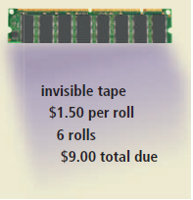
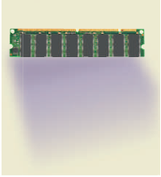
Storage (7 of 10)
Contents of Most RAM Volatile
Figure 8-2 A screen display is considered volatile because its contents disappear when power is removed. Likewise, most RAM is volatile. That is, its contents are erased when power is removed from a computer or mobile device. Storage, by contrast, is nonvolatile. Its contents remain when power is off.

Slide 11
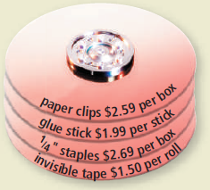
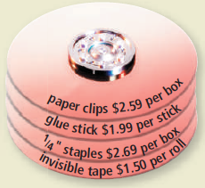
Storage (8 of 10)
Contents of Storage Nonvolatile
Figure 8-2 A screen display is considered volatile because its contents disappear when power is removed. Likewise, most RAM is volatile. That is, its contents are erased when power is removed from a computer or mobile device. Storage, by contrast, is nonvolatile. Its contents remain when power is off.

Slide 12
Storage (9 of 10)
Access time measures:
The amount of time it takes a storage device to locate an item on a storage medium
The time required to deliver an item from memory to the processor

Slide 13
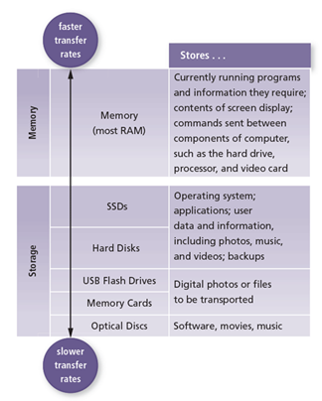
Storage (10 of 10)
Figure 8-3 A comparison of different types of storage media and memory in terms of relative speed and uses. Memory is faster than storage but is expensive and not practical for all storage requirements. Storage is less expensive but is slower than memory.

Slide 14
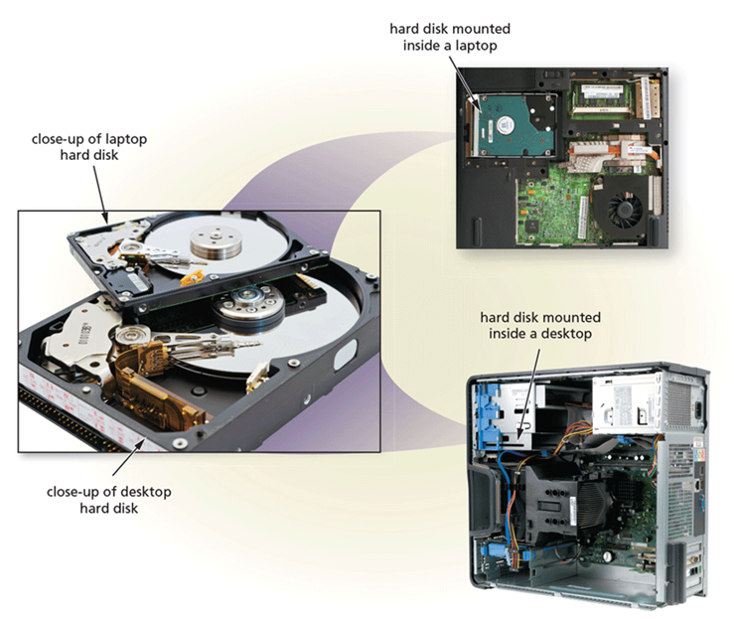
Hard Drives (1 of 9)
A hard disk, also called a hard disk drive (HDD) contains one or more inflexible, circular platters that use magnetic particles to store data, instructions, and information
Figure 8-4 The hard disk in a personal computer is enclosed inside an airtight, sealed case. In these photos of the desktop and laptop hard disks, the top plate is removed for illustration purposes. The laptop hard disk is much smaller than the desktop hard disk.

Slide 15
Hard Drives (2 of 9)
The storage capacity of hard disks varies and is determined by:
The number of platters the hard disk contains
The composition of the magnetic coating on the platters
Whether the disk uses longitudinal or perpendicular recording
Density

Slide 16
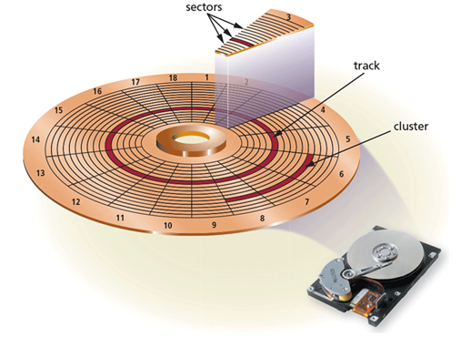
Hard Drives (3 of 9)
Formatting is the process of dividing the disk into tracks and sectors
Figure 8-5 Tracks form circles on the surface of a hard disk. The disk’s storage locations are divided into wedge-shaped sections, which break the tracks into small arcs called sectors. Several sectors form a cluster.

Slide 17
Hard Drives (4 of 9)
Characteristics of a hard disk include:
Tracks
Sectors
Platters
Form factor
Read/write head
Revolutions per minute

Slide 18
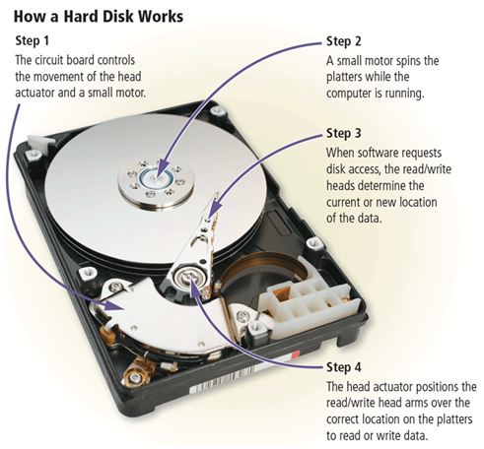
Hard Drives (5 of 9)
Figure 8-6 This figure shows how a hard disk works.

Slide 19
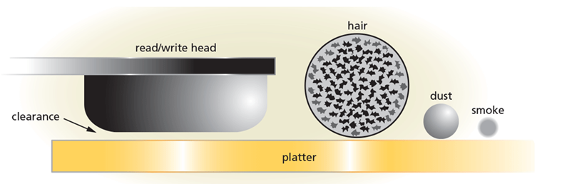
Hard Drives (6 of 9)
A head crash occurs when a read/write head touches the surface of a platter
Always keep a backup of your hard disk
Figure 8-7 The clearance between a hard disk read/write head and the platter is about two-millionths of an inch. Any contaminant could render the disk unusable.

Slide 20
Hard Drives (7 of 9)
An SSD (solid state drive) is a flash memory storage device that contains its own processor to manage its storage
An SSD (solid state drive) has several advantages over traditional (magnetic) hard disks:
Faster access times
Faster transfer rates
Quieter operation
More durable
Lighter weight
Less power consumption
Less heat generation
Longer life
Defragmentation not required

Slide 21
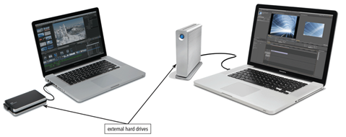
Hard Drives (8 of 9)
An external hard drive is a separate freestanding storage device that connects with a cable to a USB port or other port on a computer or mobile device
Figure 8-9 Examples of external hard drives.

Slide 22
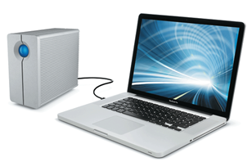
Hard Drives (9 of 9)
RAID (redundant array of independent disks) is a group of two or more integrated hard drives
Figure 8-10 An example of RAID for the home or small business user.

Slide 23
Portable Flash Memory Storage (1 of 5)
A memory card is a removable flash memory storage device that you insert and remove from a slot in a computer, mobile device, or card reader/writer
SDHC
SDXC
miniSD
microSDHC

Slide 24
Portable Flash Memory Storage (2 of 5)
microSDXC
CF
xD Picture Card
Memory Stick PRO Duo
M2

Slide 25
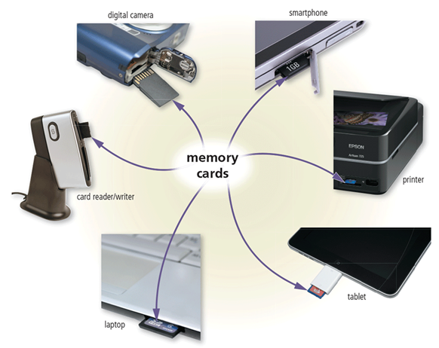
Portable Flash Memory Storage (3 of 5)
Figure 8-11 Many types of computers and devices have slots for memory cards.

Slide 26
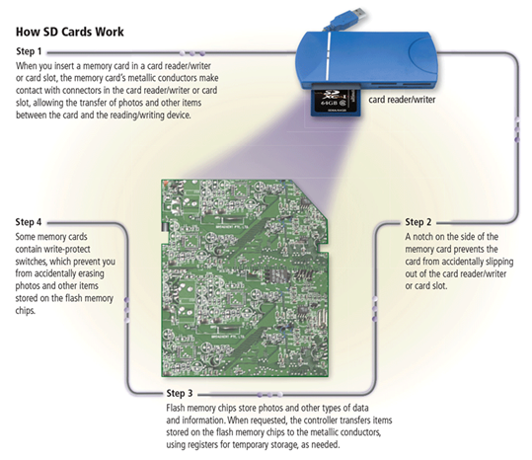
Portable Flash Memory Storage (4 of 5)
Figure 8-12 This figure shows how an SD card works.

Slide 27
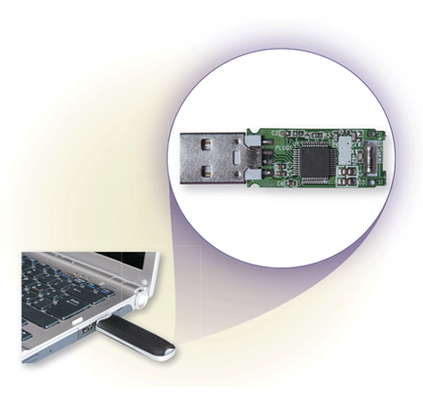
Portable Flash Memory Storage (5 of 5)
USB flash drives plug into a USB port on a computer or mobile device
Figure 8-13 A close-up of the flash memory and circuitry inside a USB flash drive.

Slide 28
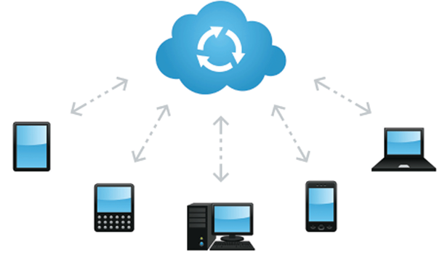
Cloud Storage
Cloud storage is an Internet service that provides storage to computer or mobile device users

Slide 29
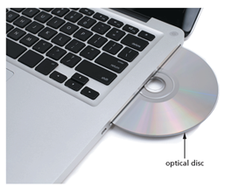
Optical Discs (1 of 5)
An optical disc consists of a flat, round, portable disc made of metal, plastic, and lacquer that is written and read by a laser
Figure 8-14 An optical disc in a disc drive.

Slide 30
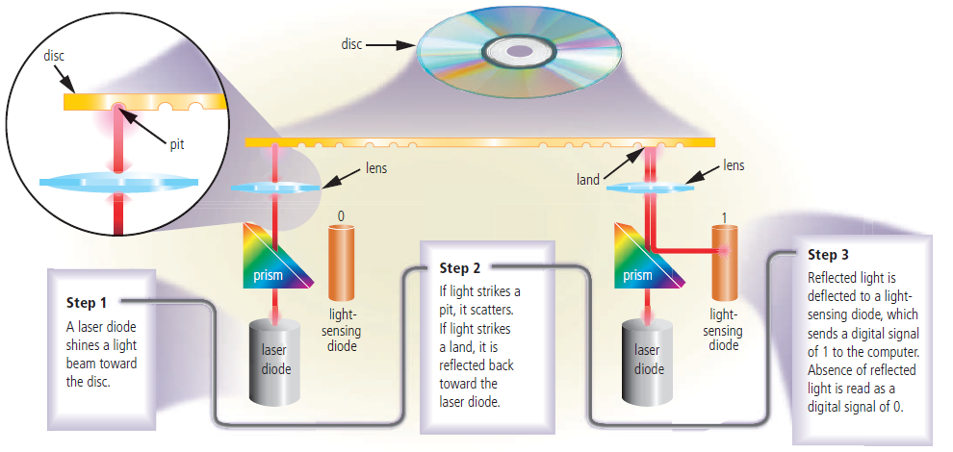
Optical Discs (2 of 5)
How a Laser Reads Data on an Optical Disc
Figure 8-15 This figure shows how a laser reads data on an optical disc.

Slide 31
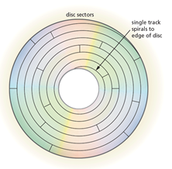
Optical Discs (3 of 5)
Optical discs commonly store items in a single track that spirals from the center of the disc to the edge of the disc
Track is divided into evenly sized sectors
Figure 8-16 An optical disc typically stores data, instructions, and information in a single track that spirals from the center of the disc to the edge of the disc.

Slide 32
Optical Discs (4 of 5)
A CD-ROM can be read from but not written to
Single-session disc
A CD-R is an optical disc on which users can write once, but not erase
A CD-RW is an erasable multisession disc

Slide 33
Optical Discs (5 of 5)
A DVD-ROM is a high-capacity optical disc on which users can read but not write on or erase
A DVD-R or DVD+R are competing DVD-recordable WORM formats, on which users can write once but not erase
DVD-RW, DVD+RW, and DVD+RAM are competing DVD-rewritable formats that users can write on multiple times

Slide 34
Enterprise Storage (1 of 7)
Enterprise hardware allows large organizations to manage and store data and information using devices intended for heavy use, maximum efficiency, and maximum availability
RAID duplicates data, instructions, and information to improve data reliability

Slide 35
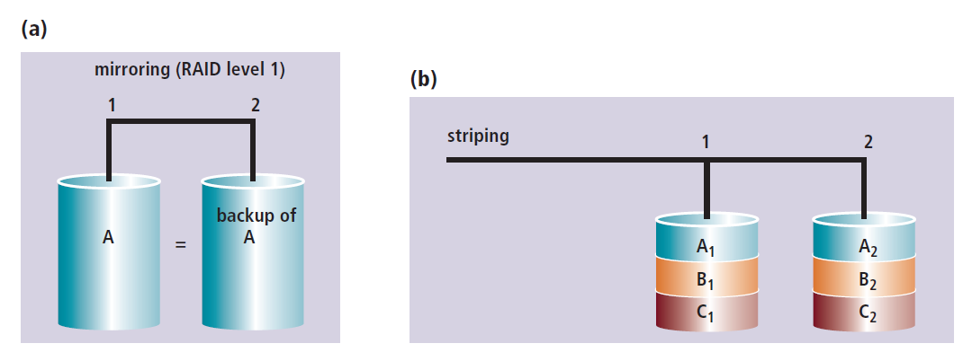
Enterprise Storage (2 of 7)
Figure 8-18 In RAID level 1, called mirroring, a backup disk exists for each drive. Other RAID levels use striping; that is, portions of each drive are placed on multiple drives.

Slide 36
Enterprise Storage (3 of 7)
Network attached storage (NAS) is a server that is placed on a network with the sole purpose of providing storage to users, computers, and devices attached to the network

Slide 37
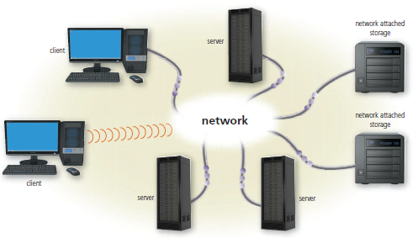
Enterprise Storage (4 of 7)
Figure 8-19 An example of how network attached storage connects on a network.

Slide 38
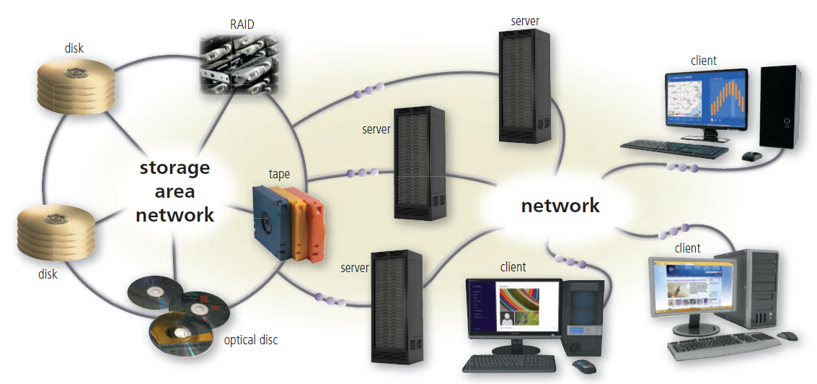
Enterprise Storage (5 of 7)
A storage area network (SAN) is a high-speed network with the sole purpose of providing storage to other attached servers
Figure 8-20 A storage area network provides centralized storage for servers and networks.

Slide 39
Enterprise Storage (6 of 7)
Tape is a magnetically coated ribbon of plastic capable of storing large amounts of data and information
A tape drive reads and writes data and information on a magnetic tape

Slide 40
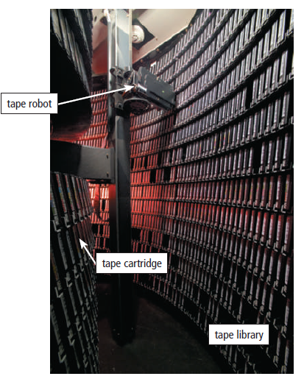
Enterprise Storage (7 of 7)
Figure 8-21 A tape robot retrieves tape cartridges.

Slide 41
Other Types of Storage (1 of 7)
A magnetic stripe card has a magnetic stripe that contains information
A smart card stores data on an integrated circuit embedded in the card

Slide 42
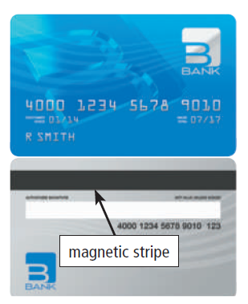
Other Types of Storage (2 of 7)
Figure 8-22 The magnetic stripe on the back of credit cards and other ID cards contain information that identifies you and the card.

Slide 43
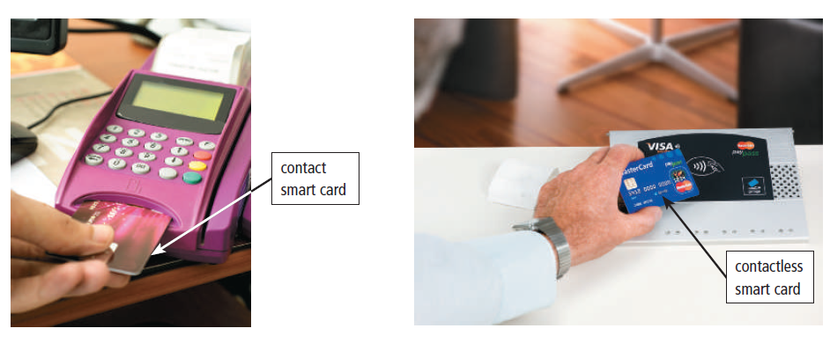
Other Types of Storage (3 of 7)
Figure 8-23 Examples of contact and contactless smart cards and their readers.

Slide 44
Other Types of Storage (4 of 7)
The RFID tag consists of an antenna and a memory chip that contains the information to be transmitted via radio waves
An RFID reader reads the radio signal and transfers the information to a computer or computing device

Slide 45
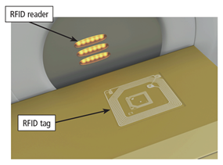
Other Types of Storage (5 of 7)
Figure 8-24 An RFID reader reads radio signals from an RFID tag that is affixed to this box.

Slide 46
Other Types of Storage (6 of 7)
An NFC-enabled device contains an NFC chip
An NFC tag contains a chip and an antenna that contains information to be transmitted
Most NFC tags are self-adhesive

Slide 47
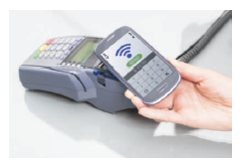
Other Types of Storage (7 of 7)
Figure 8-25 This NFC-enabled phone communicates with the NFC reader to send a mobile payment.

Slide 48
Summary
Variety of storage options
Storage capacity and storage access times
Characteristics of hard disks, SSDs, external hard drives, and RAID
Portable flash memory storage
Advantages and various uses of cloud storage
Characteristics of optical discs
Enterprise storage options
Magnetic stripe cards, smart cards, RFID tags, and NFC chips and tags

